Slide 1
Keeping Things Tidy
How to clean up the events

Slide 2

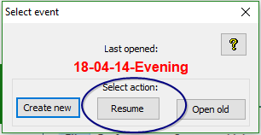
Start BOS

Slide 3
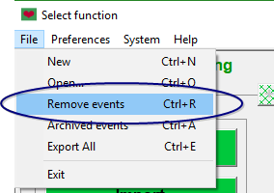

Slide 4
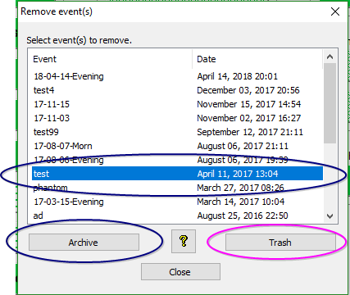
Select event to be removed
Click either “Archive” or “Trash”

Slide 5
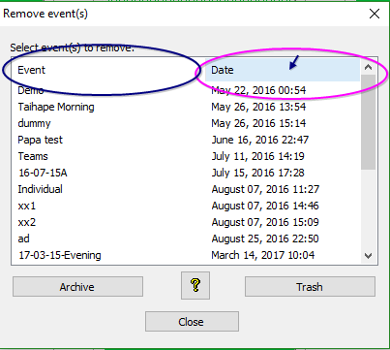
The list may be sorted by event name or by creation date by clicking on the appropriate heading.

Slide 6
Keep the BOS sessions tidy and users will not have problems selecting the correct session to run
Let them get too full and users will select the wrong session and this has the potential to cause problems.

Slide 7
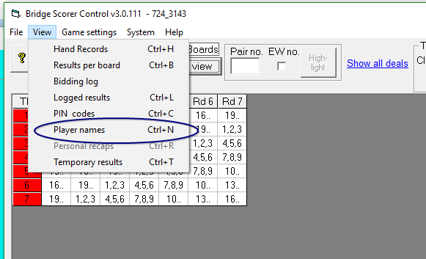
Changing Player Names

Slide 8
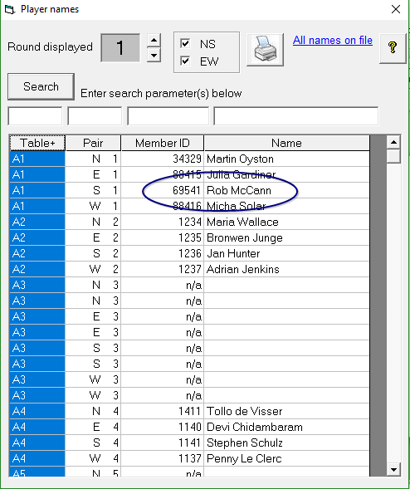
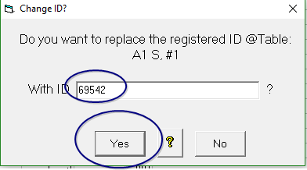

Slide 9
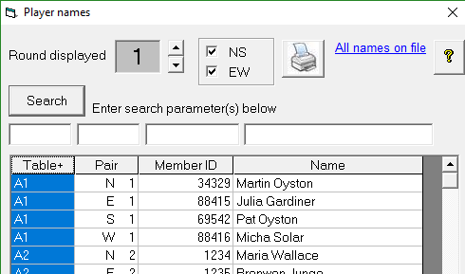

Slide 10
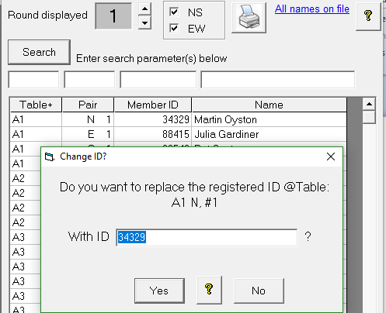

Slide 11
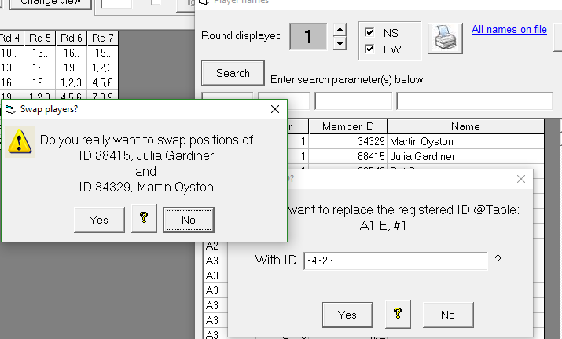

Slide 12
IMPORTANT
Correct the player numbers before uploading names
If you have uploaded names already – no problem, just upload again after the changes.

Slide 13
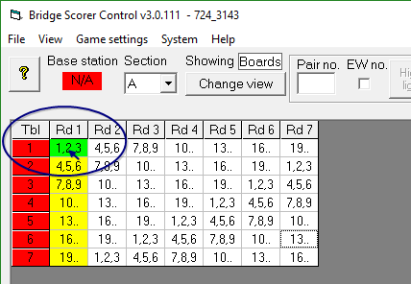
CAHNGING SCORES

Slide 14
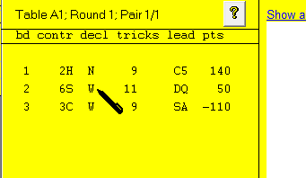
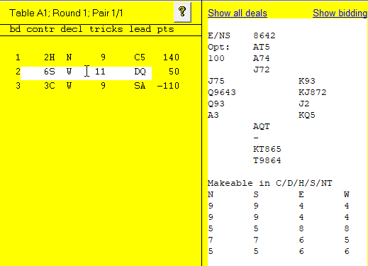

Slide 15
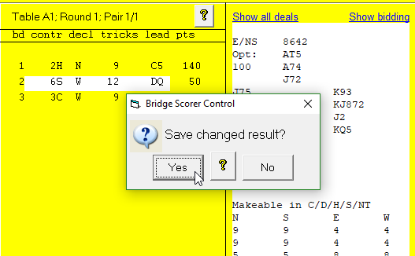
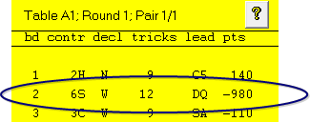

Slide 16
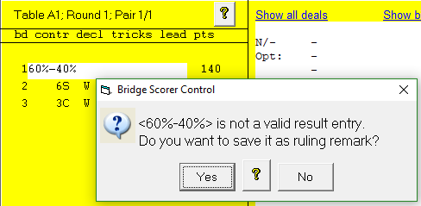
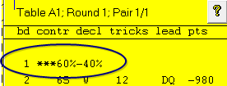
IMPORTANT POINTS
The number of tricks is entered – making “6” is 12 tricks
The hand record is shown to assist you.
Scores can be entered in the cells for missing boards
Adjustments can be made in the form 60%-40%
Remember to remove all the information from the line before entering the adjustment.
When the scores are uploaded, the adjustment is automatically applied

Slide 17
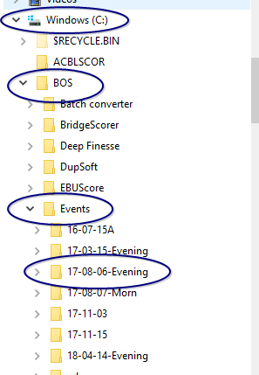
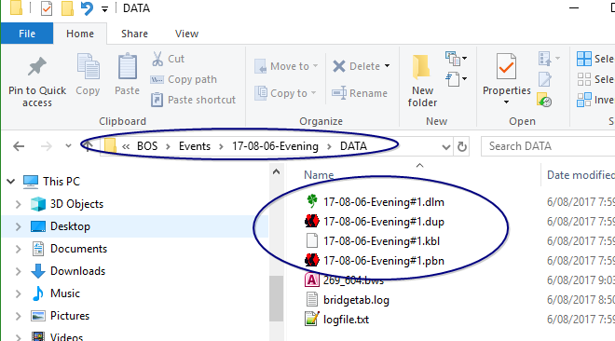
NOTE on locating dealing file

