Slide 1
BridgeTab
Guide for running smooth sessions…

Slide 2
Overview
Long Before the session
Before the session
During the session
After the session

Slide 3
HAND GENERATION & DEALING
It is recommended that this system change to a much easier and less user-dependent option using BOS.

Slide 4

Starting BOS
Use the BOS icon on your desktop or quick-start bar to start BOS
Create New
Open Old
Notes:
Next slide for New BOS session – slide 10 for Open Old

Slide 5
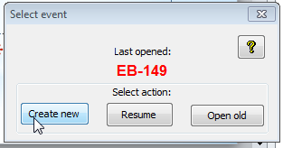
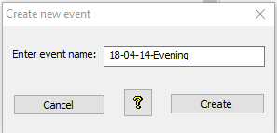
NEW BOS Session
Create a NEW session in BOS
Give the session a name
Prefer to use a name starting yy-mm-dd-Session
Keep the naming convention easy
NEVER use 2 spaces together or special characters in the name of a session

Slide 6
Examples:
5 May 2018
7 Feb 2018
2 June 2018 Morning
2 June 2018 Afternoon
18-05-05
18-02-07-Jones-Pairs
18-06-02 Morning
18-06-02 Afternoon

Slide 7
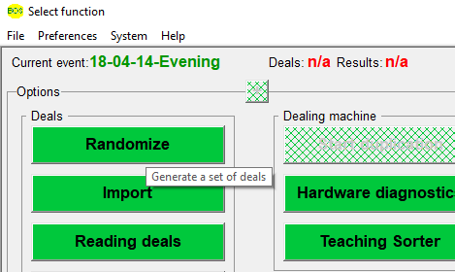
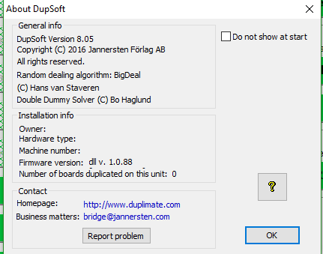
Generate Deals
In the new BOS session, choose “Randomize” to generate a new set of deals.
The above screen appears for about 5 seconds then disappears

Slide 8
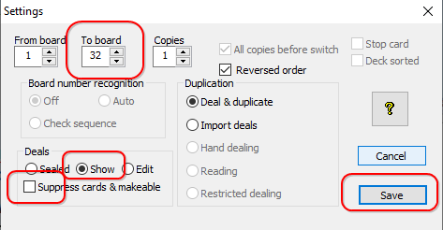
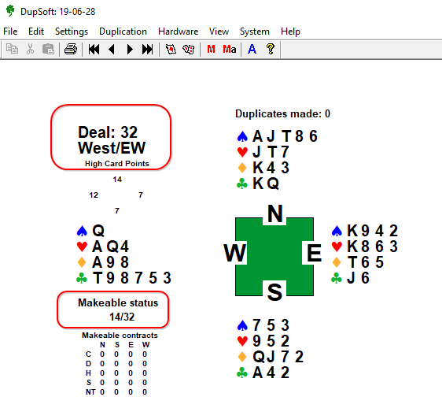
Now set the number of deals you want for the session.
Then click SAVE
In a short time, the DupSoft screen (right) appears:
The numbers under “Makeable Contract” will keep increasing until all the contracts are analysed.
Generate Deals

Slide 9
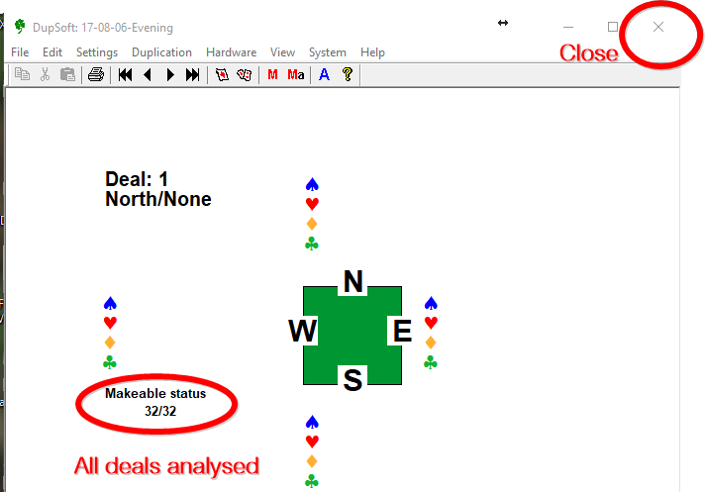
Analyse
You may need to click on Ma to start the analysis.
This creates the necessary files for display on BridgeTabs
Wait until all the deals are analysed before closing this. You can minimise.
NOTE: The (pbn) dealing file is NOT created until the DupSoft window is closed.

Slide 10
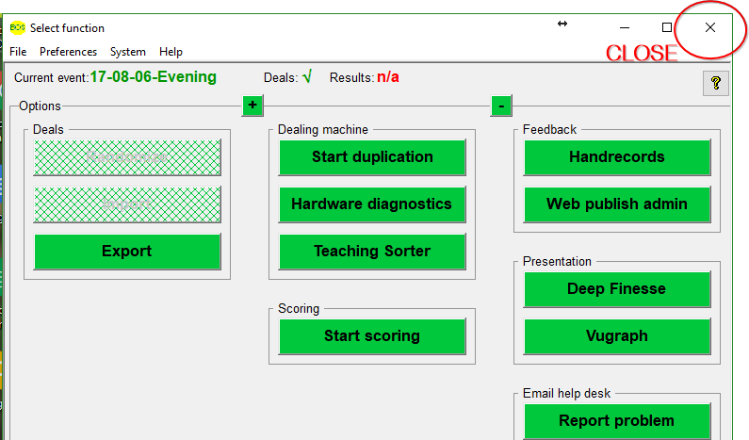
Finalise Deals
When all contracts are analysed, close this window with the cross in the top right OR choose File →Exit
You can now CLOSE BOS
OR choose
File → New
To start a new session and generate another set of deals.
OR “Start Scoring” if you are ready for that.

Slide 11
See dealing process
This completes the deal generation.
Click the link below to continue the dealing process with Dealer4.
Continue to the nightly scoring process.

Slide 12
Running the night
Start BOS

Slide 13
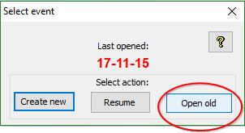
Open Existing Session
You will use ‘Open old’ if the session has already been set up in BOS

Slide 14
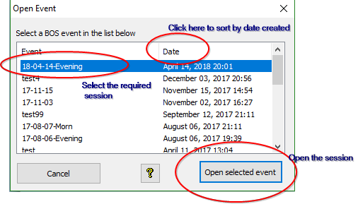
Select your event and ‘Open selected event’

Slide 15

From BOS you can now click ‘Start scoring’
This will start Scorer AND will start the communications programme for the BridgeTabs (BTAdmin).

Slide 16
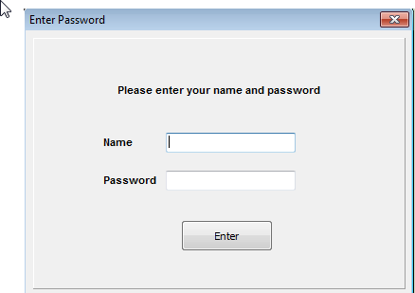
Scorer now starts ..
Log in to Scorer …

Slide 17

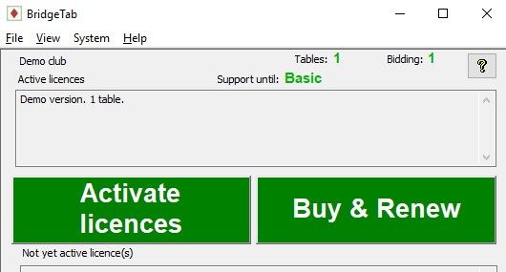
You should notice the BridgeTab icon at the bottom of the screen
This screen is used to check licences and also to confirm the computer’s IP address (needed by the BridgeTabs)

Slide 18
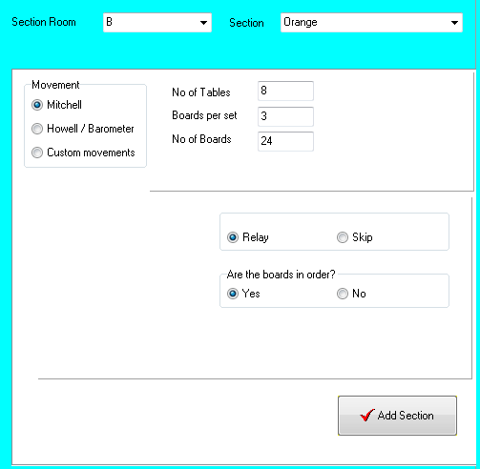
Back to Scorer, and create your session in the normal way – set up the section(s).
Usually you only have one section
NOTE: If more than one section,
use different letters for the Section Room
Each section will use a DIFFERENT room and colour in the setup

Slide 19
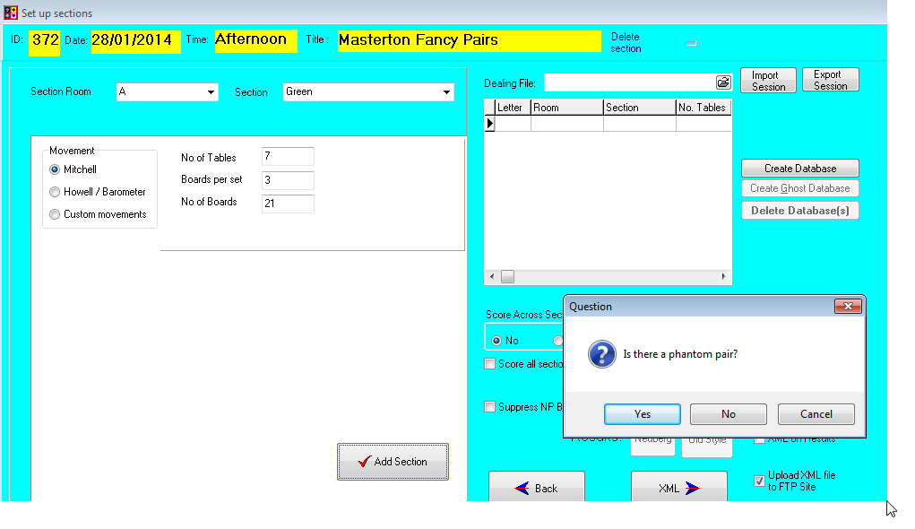
Typical session setup

Slide 20
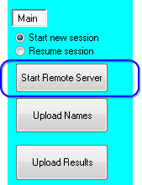
STARTING THE SERVER
Once the session is added, click ‘Start Remote Server’
The radio buttons ‘Start new session’ and ‘Resume session’ are primarily for BridgePad and do not have any effect on BridgeScorers.

Slide 21
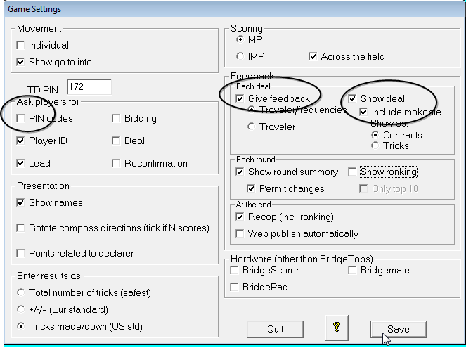
The defaults will be set and stay unchanged for most sessions
Points related to declarer will give:
If ticked
EW
-500
For
3HX E -2 Vul
If NOT ticked
NS
500
For
3HX E -2 Vul
Note: Those settings circled need to be changed currently for tournaments

Slide 22
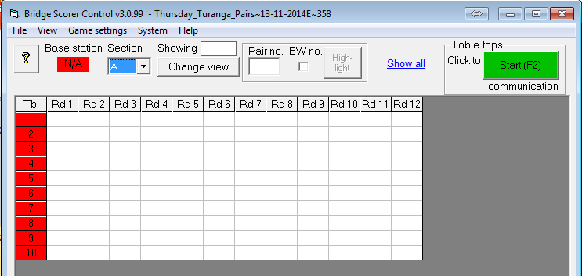
Ready to Rumble
One last step .. Click Start
Since you are using the network, Base station is not required, so the red box with N/A is not relevant at all.

Slide 23
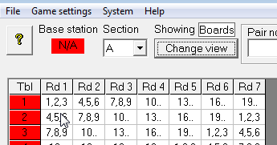
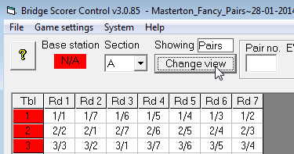
Finding Nemo?...
Using ‘Change view’ shows either board numbers or pair numbers at the table for the round

Slide 24
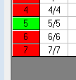
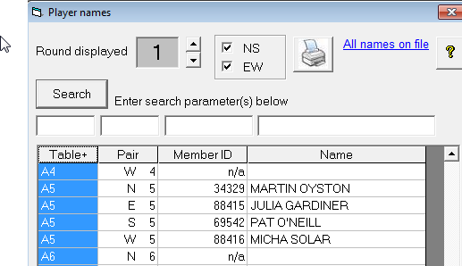
As the tables connect, the ‘Tbl’ number turns green
Use Ctrl-N [or View → Player Names] to display names entered
(Close this window and re-open to refresh the name list)

Slide 25
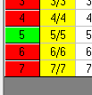
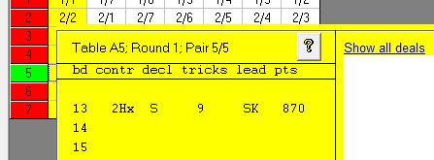
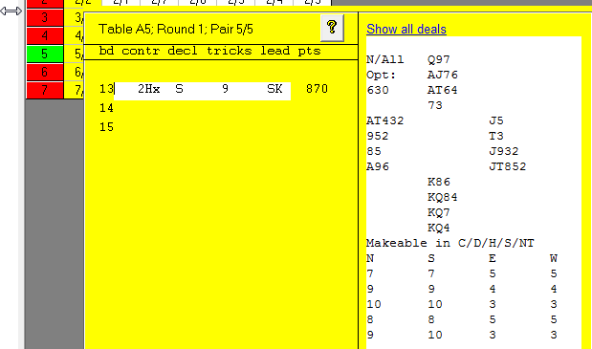
When the first result comes in for the round, the entire round column turns yellow.
Clicking on the round cell displays the results received
Clicking on the result line displays the hand record also. The Director is able to modify a result from here if required.

Slide 26
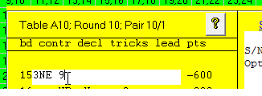
Director changing results
Note that changes can be made on the computer if the director is confident the change is required.
Click on the cell with the result, and you can enter a result or modify an existing result
Format for the entry is:
Contract Declarer result
Best form for result is the
NUMBER OF TRICKS MADE

Slide 27
Change on BridgeTabs
On the BridgeTabs, if a player has entered a result incorrectly then they are usually able to correct it themselves in the same round by pressing on the incorrect result and changing it.
If the BridgeTab has gone to a subsequent round, then the TD may access the results in the TD menu by holding the ? For 5 seconds and typing in the PIN set for the session.
This process allows the Director to modify the result on a board played at that table or assign an artificial adjusted score.

Slide 28
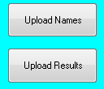
From Scorer you can Upload Names at any time – best to give the players a chance to get them in so after the first round is OK or you can wait till the end.
When all results are in (all cells green) then Upload Results
NOTE: you can stop the server and close it down at the end of play, but the BridgeTab and Scorer are effectively independent and one does not need to be running for the other to be fully functional.

Slide 29
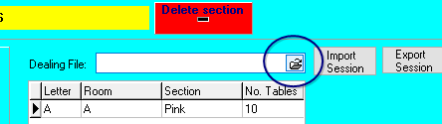
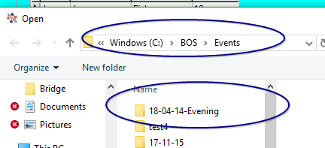
Attach Dealing File
Before sending results to the web, attach the dealing file.
If this is forgotten, then it can easily be attached later and sent again with XML.

Slide 30
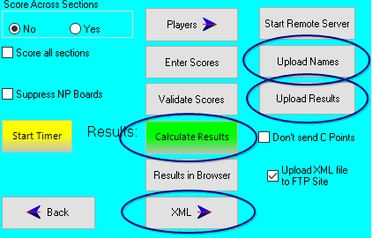
Once names and results are uploaded, click
Calculate Results.
Click XML to send the results to the web.
NOTE: The C-points are sent when the Results report is closed unless the “Don’t Send C-points” check box is ticked. It would be unusual to tick this and only tick it if you are checking the effect of an adjustment.

Slide 31
Finishing up …
Now close Scorer
Close BOS
Shut down
Enjoy the company

Slide 32

Summary
Start BOS
Open Old – select correct BOS event for session – Open selected event
Start Scoring
Check BTAdmin icon is in the taskbar
Score/Ladder
Select session
Set up section(s)
Start Remote Server
Save
START [in BSControl]

Slide 33
Making Changes in BSControl
Change names in BSControl
Ctrl-N OR View → Player Names
Change number of player who is incorrect
NOTE: IF the player is already entered, then you will be prompted to SWAP the players
Click on a cell to see the boards played at that table in that round
Click on the line with the contract/result to be changed
Make the changes then press ENTER .. Accepting the changes if correct
Acceptable Results
2H S = Result .. 140
2H S 8 Result .. 140
2H S 2 Result .. -300 [OR -600 VUL]
60%-40% Adjusted score
empty or NP Not played
REMEMBER Changes made in BSControl will be uploaded to Scorer with “Upload Names” and “Upload Results” buttons in Scorer

Slide 34
Making Changes in Scorer
IF a player name is changed in Scorer (in the Enter Names screen) then uploading names again will undo this change!
IF a score is changed (in the Enter Scores screen) then uploading results will undo the changes!
IMPORTANT: Changing results in Scorer without correcting the contract in BSControl [or using “Edit Received Data”] will result in inconsistent results on the website such as 2H S 4 420 when the scorer in Scorer was changed to 420 but the contract in the BridgeTab was not changed to 4H.

Slide 35
Data Flow
BridgeTab
BSControl
Scorer
Web

