Slide 1
Dealing files generated with BOS
Presentation by
BridgeNZ

Slide 2

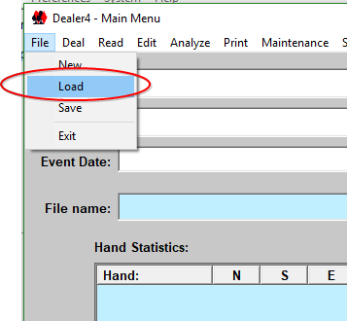
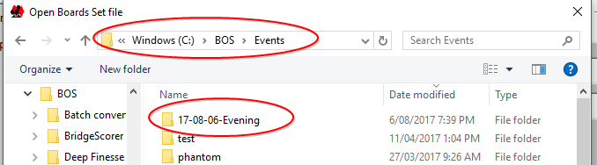
Start Dealer4
Start Dealer4 using the Dealer4 icon on the desktop or in the Quick Start menu
Click File → Load
This should open in the folder C:\BOS\Events with your newly created events folder at the top of the list.

Slide 3
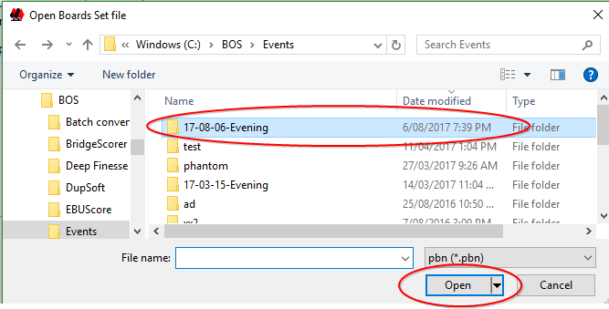
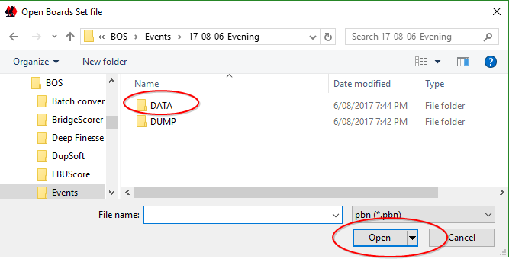
Finding the pbn file
Click on the required folder (session day) then click OPEN
[Or just double-click the folder]
Now click on DATA then OPEN

Slide 4
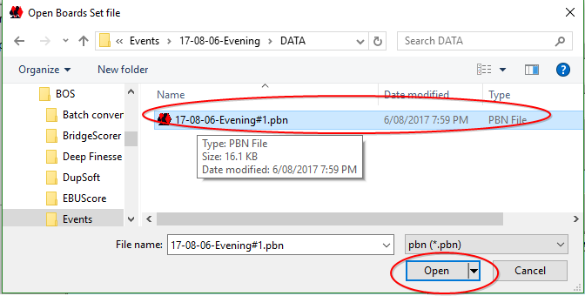
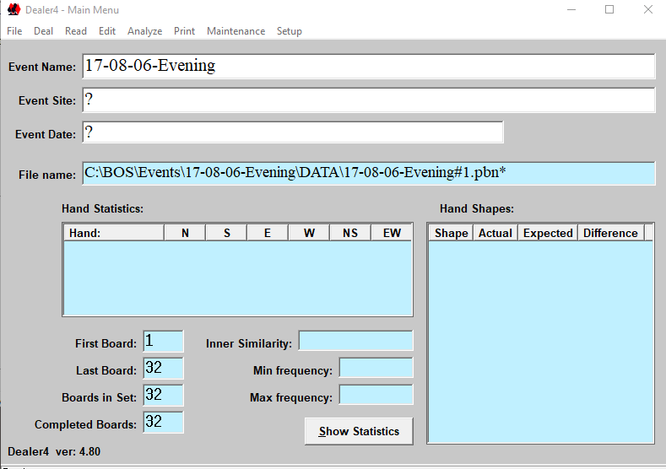
Finding the pbn file
Then on the filename and OPEN
Now deal as usual by clicking DEAL – when finished close Dealer4

Slide 5
Final Notes
NOTE: If you want to print hand records from Dealer4, then you may need to click Analyse in the top menu bar to get the makeable contracts.
Repeat the process from the top for other nights – creating the BOS event and generating the deals there then opening Dealer4 and dealing the boards.

Slide 6
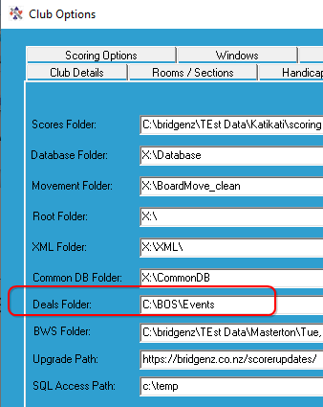
Scorer Setup
In the Scorer Options → Files tab
Set the Deals Folder to the appropriate place to retrieve the deals for the session.

